Slide 1



Identifying women harassment in public cctv camera using AI technique
AMBARISH KUMAR L & 192IT113
KARTHIK V & 192IT163
AKASHRAJ S &192IT112
ARUN KUMAR T & 192IT115
Mr.PURUSOTHAMAN P,
Incharge - AI Special Laboratory,
BIT,
Sathy.

Slide 2
Abstract
Nowadays there are news of women harassment is more than their achievements. To decrease the incidence of sexual harassment faced by women experiences in a year and to increase women confidence to step out to their office during nights and desire to use public spaces in the city especially at night. Women feel unsafe to travel alone at odd hours. There are many android applications that are developed for women safety. But it is not always possible to carry our mobile phones wherever we go or sometimes we forget to carry it. Even there are many uneducated women those who do not have android phones or do not know how to handle it. The proposed system is an attempt made to solve the problems of women safety. Surely there will be CCTV cameras in every public place. We just need to apply the algorithms on that CCTV cameras no special hardware’s are required. Then the gender of the person will be predicted. If any unusual activity of person is recognized by a camera then the alert message will be sent to the nearby police station Which makes them alert. This project is made for the conveniences of all women.

Slide 3
problem we try to address?
Now a days Safety of women has become a major issue in India. The crime rate against the women in the country have only risen to a great extent. Women think twice before stepping out of their homes, especially during the night time. However people do not follow these rules. Women contribute to the growth and development of our country. Few Prominent Women are now on respected positions in the country but if we take a look behind the curtains we see even then they are being exploited to an unbearable extent. Each day we read about horrific crimes being committed against women in our country. It became casual or normal now a days. Not a day goes by where you do not hear of a crime against women in India. In fact there are at least five news articles that tell us about the horrific details of the various crimes. It is extremely painful to watch the status of women safety in India. The aim of this project is to develop a security system especially for women to protect themselves from present day physical harassments. It has wide range of features and functionality like providing a live camera detection. So that, the victim cannot be escaped easily. This would help to reduce the crime against women in which the image of the person can be captured easily and act as solid evidence against the crimes.

Slide 4
What differentiates our idea from similar solutions/Idea?
All other ideas and solution given before is to have an android or iOS phone in your hand but in this a live accessing camera can be taken into control using artificial intelligence. Many of us do not know how to use android applications or the do not have such kind of applications with them. As compared to other applications it is purely based on automation and does not need any special training to handle it. In this technology you do not need to carry something along with you wherever you go. you will be directly monitored by the higher officials of your locality. User does not want to accept any type of terms and conditions. As compared to ours all the other application will be using complicated technology that makes the user to feel inconvenient.
Beneficiaries of the project
Help to improve safety of women.
Help reduce crime against women.
Help police to take immediate action against criminals does not require any kind of hardware

Slide 5
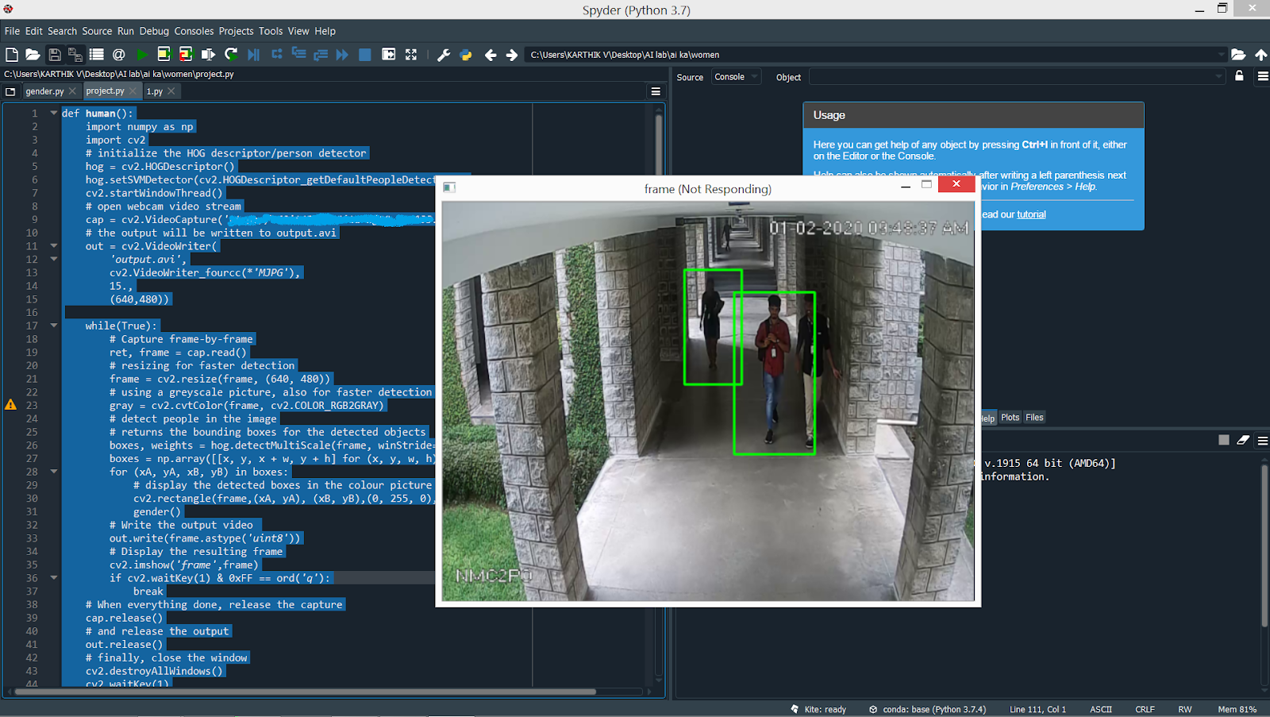
Human detection:

Slide 6
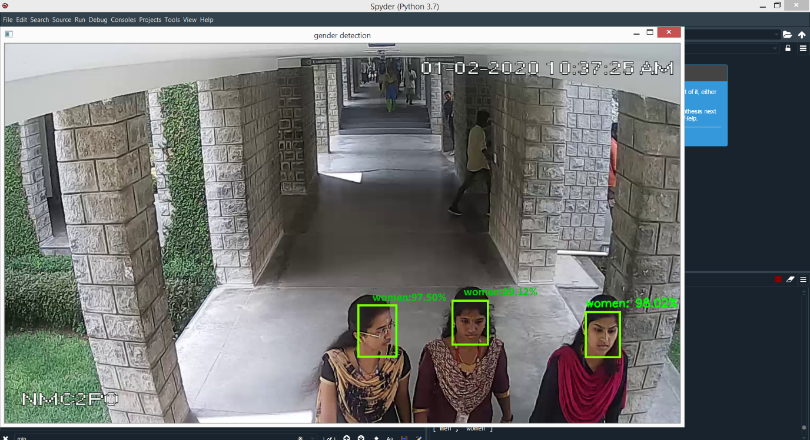
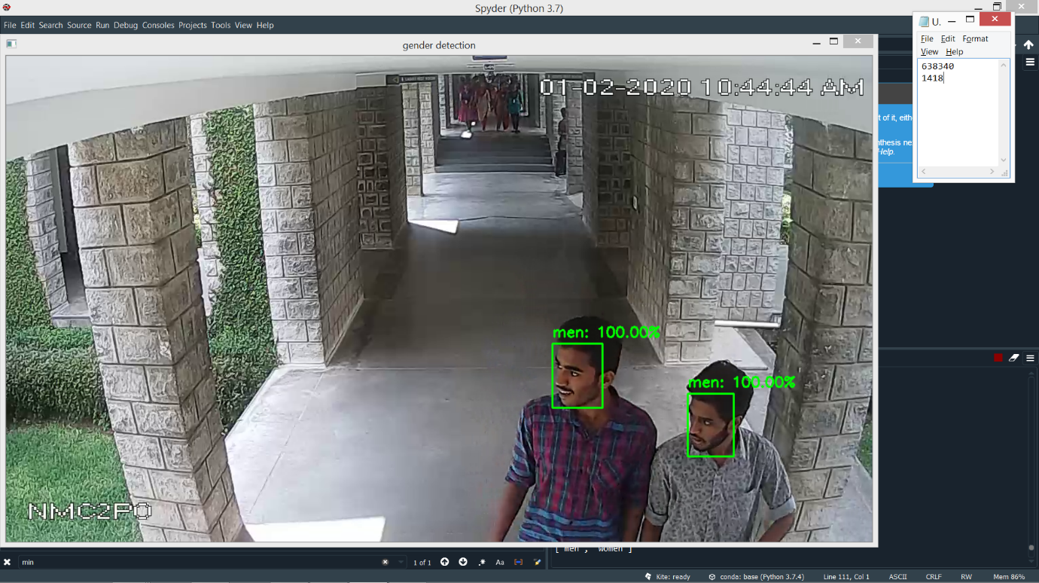
Identifying men and women in a live stream:

Slide 7
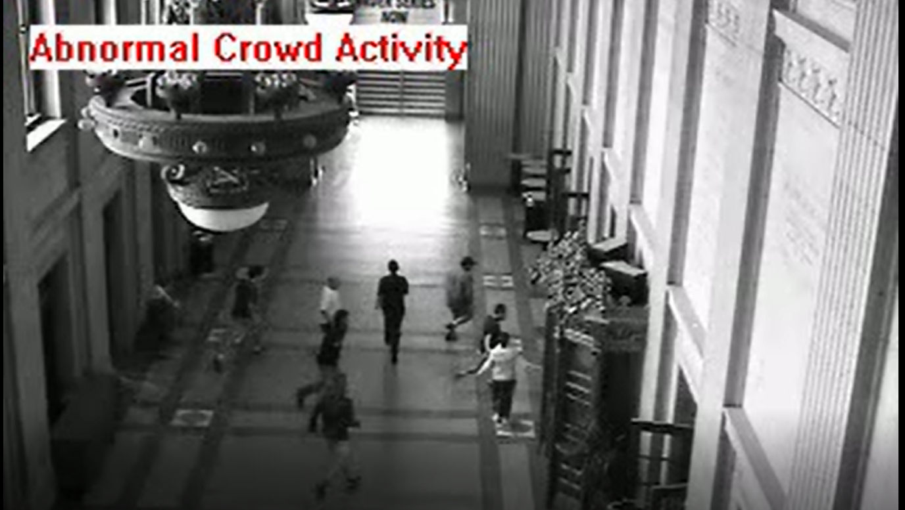
Abnormal behaviour identification:

Slide 8
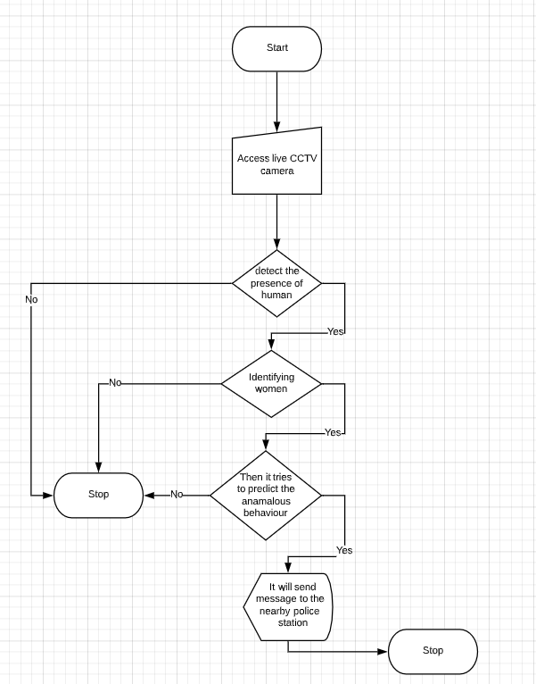
Flow Diagram

Slide 9



Project Work Plan

Slide 10
Thank You

